Slide 1
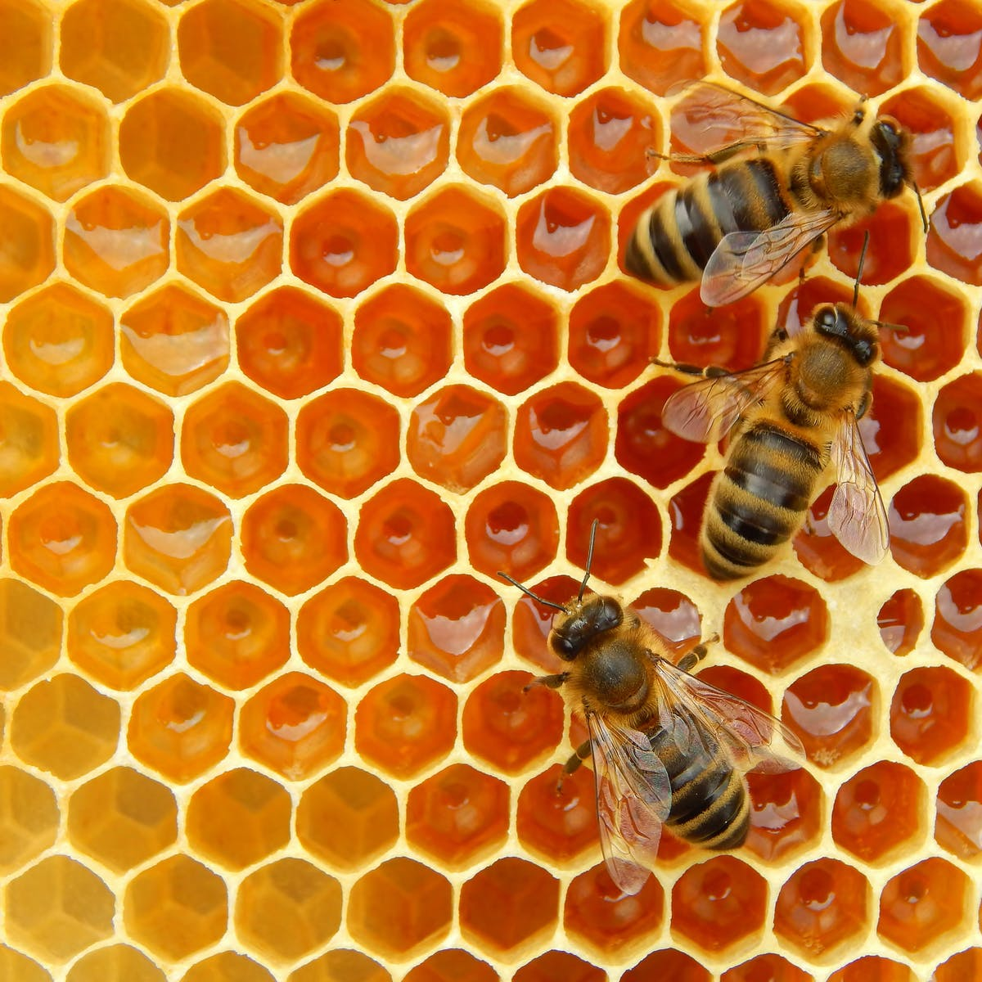
Using the waggle dance to quantify collective foraging in honeybees
Joe Palmer, Ash Samuelson, Elli Leadbeater & Vincent Jansen
Notes:
Hi I’m Joe, a third year PhD student of Elli and Vincent’s and I am going to briefly outline my PhD research so far, which is all about creating new methods to analyse how honeybees use information when foraging in different environments.

Slide 2




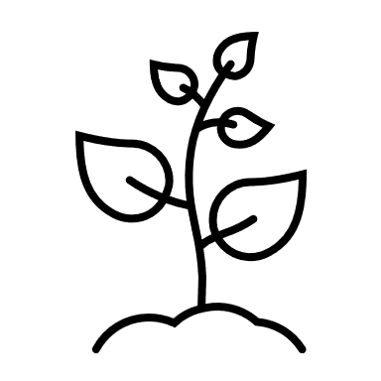
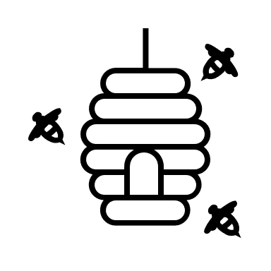

X10
X3
Scout
Recruit
Notes:
Very broadly, when honeybees forage they can either act as a scout or a recruit.
Imagine some hive situated in an environment with flower patches of different qualities.
A scout will head off on a random trajectory and search without information until they find a flower patch.
They then return to the hive and perform waggle dances for that resource to provide the location to nest mates. Crucially, when they dance the convey how good they think the resource is by the number of waggle runs performed, with more profitable resources eliciting more dances. In the hive recruits wander the dance floor randomly and so are more likely to encounter a dance for a profitable resource.
They then also go out and forage at these sites.
And will also perform dances for that resource on their return, creating a collective process which pools individual information to identify the best resources.

Slide 3


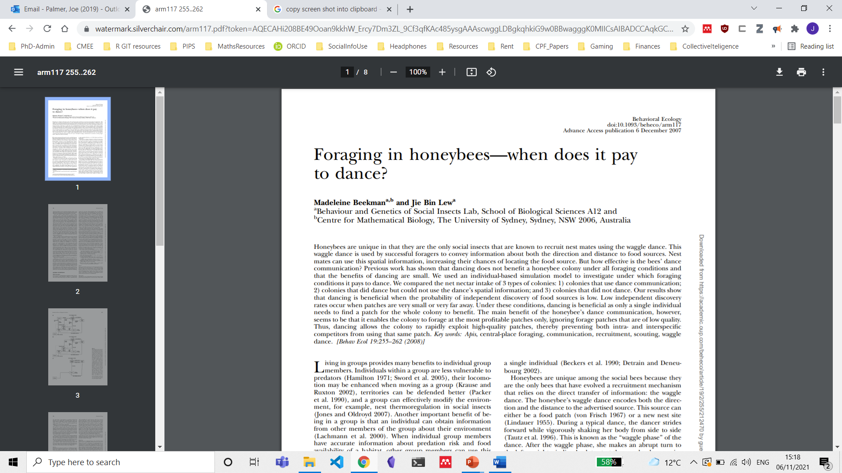
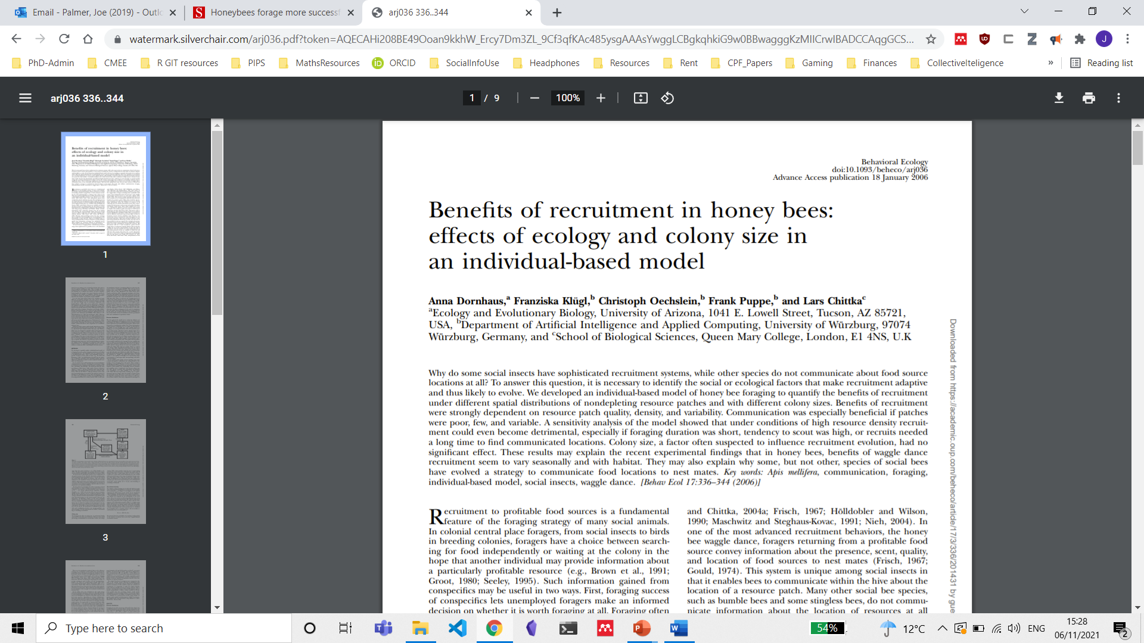
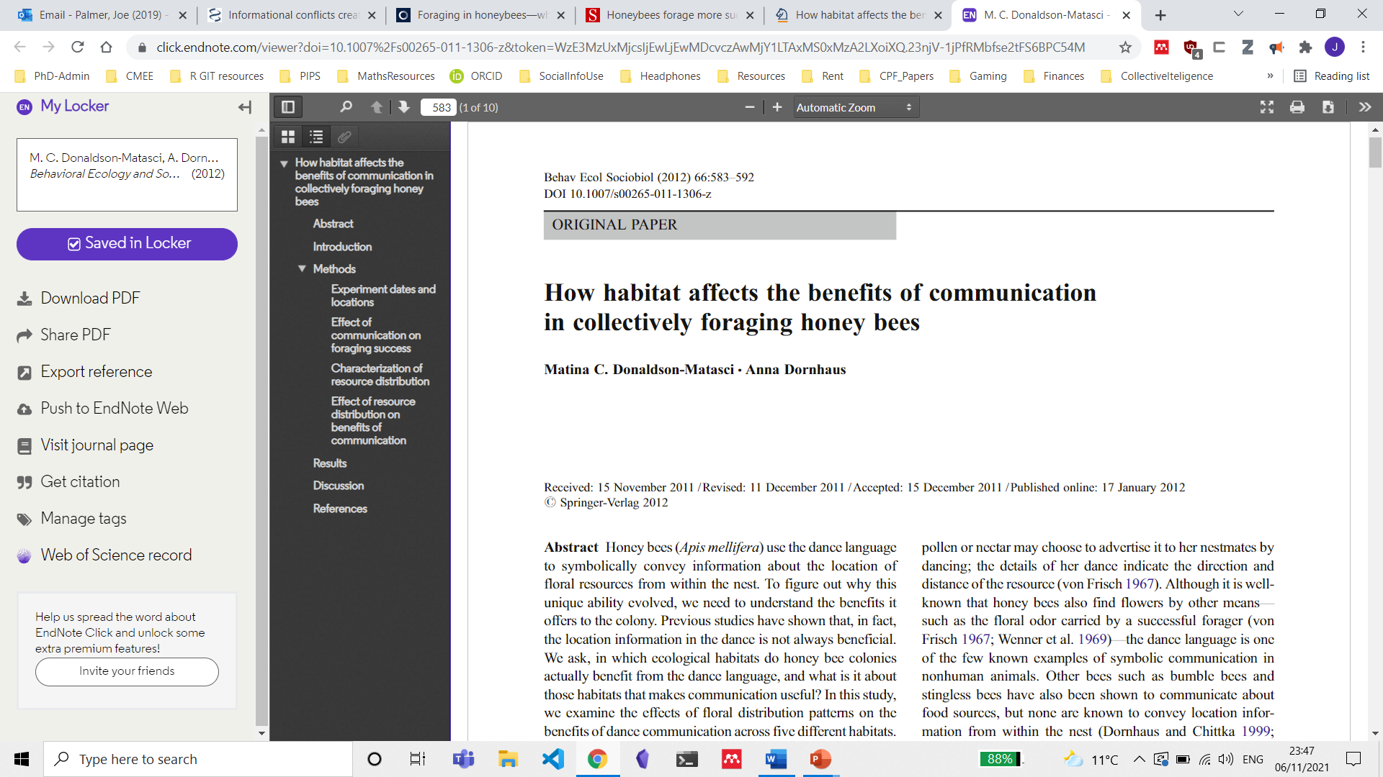
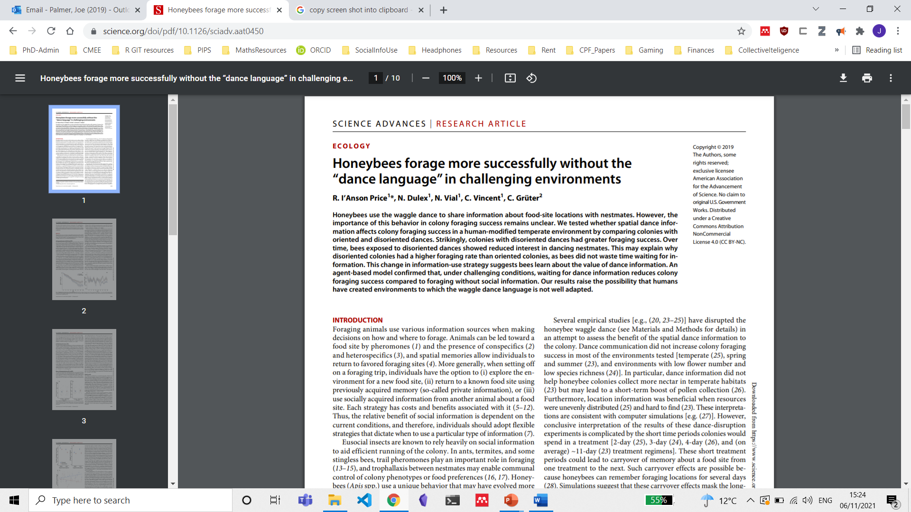
Prioritise personal information
(Act like a scout)
Prioritise Social information
(Act like a recruit)
Notes:
Within this system, individuals have a choice of how to behave.
They can either behave as scouts, I.e. search the environment and priorotise their own information
or they can behave as recruits and follow the dances of others, and so priorotise social information. Exactly what determines how a colony balances these two information streams has been studied in great detail.
Some theoretical papers suggest when resources are difficult to find a colony should use the waggle dance more as then only a single individual needs to find a resource.
Others suggest they should use personal information use more when resources are hard to find rather than wait for personal information.
Empirical evidence now suggests this latter idea seems to be the case, however, the methods used contrast foraging success with or without the dance, not whether a colony alters its use of the dance.

Slide 4
How to evaluate the influence of the environment on waggle dance use?
Vs.
p
+
(1-p)
Notes:
This question of how the waggle dance is used in different environments is important as it gives us an idea both of what conditions lead to the evolution of the dance in the first place, as well as social information use in general, and how changing environmental conditions are influencing waggle dance use
To answer this question we need a better understanding of what foraging looks like under an individual or collective strategy and a methodology which allows us to compare the two. This fundamentally difficult as we can often observe one of the other but not both bahaviours at the same time. This is when we had a brain wave.
All foragers report information on the dance floor of where they’ve been.
Because of this, resources found under different foraging strategies should be identifiable from the distribution of dances reported on the dance-floor.
Now I’m not going to go into how we validated these ideas because it’s a little dry and I only have 10 minutes,but we used this idea to create a model of collective honeybee foraging made up of individual and collective foraging.
Importantly, because we did it this way we can calculate the extent to which dances stem from the use of personal or social information and obtain this value P which captures this information as the proportion of scout dances on the dance floor.

Slide 5

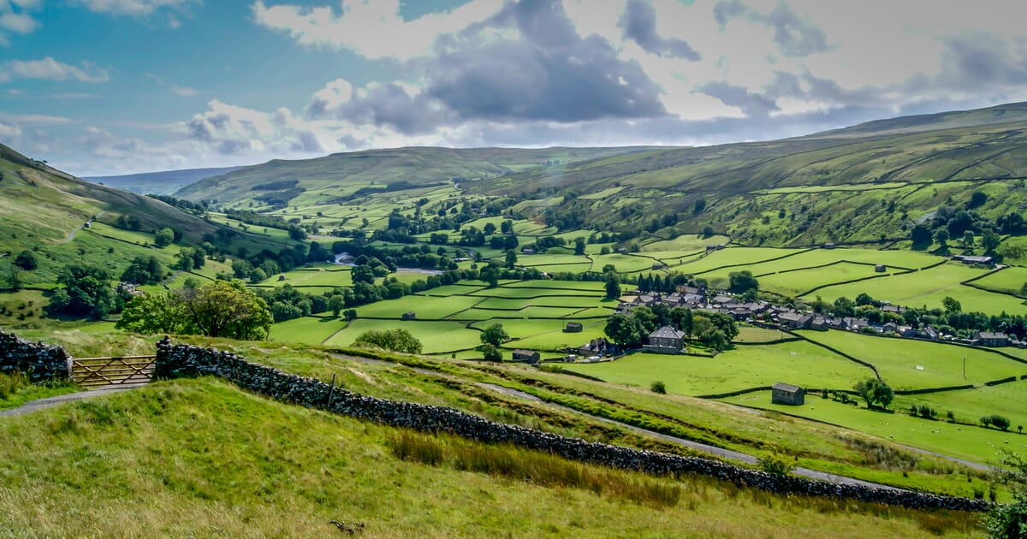
Fit our model to waggle dance data from 20 hives, collected across two years in an urban and agri-rural environment (10 sites in each).
Evaluate how environment influences waggle dance use (P)
p
+
(1-p)
Vs.
Notes:
We fit this model to a large empirical data set of over 3000 waggle dance observations collected from hives in an urban and argi-rural landscape.
The first thing we wanted to evaluate was whether honeybees foraged collectively, following our full model
or individually, using just the individual component of the model.
We then wanted to investigate how aspects of the environment influenced the proportion of scout dances identified from our model.

Slide 6
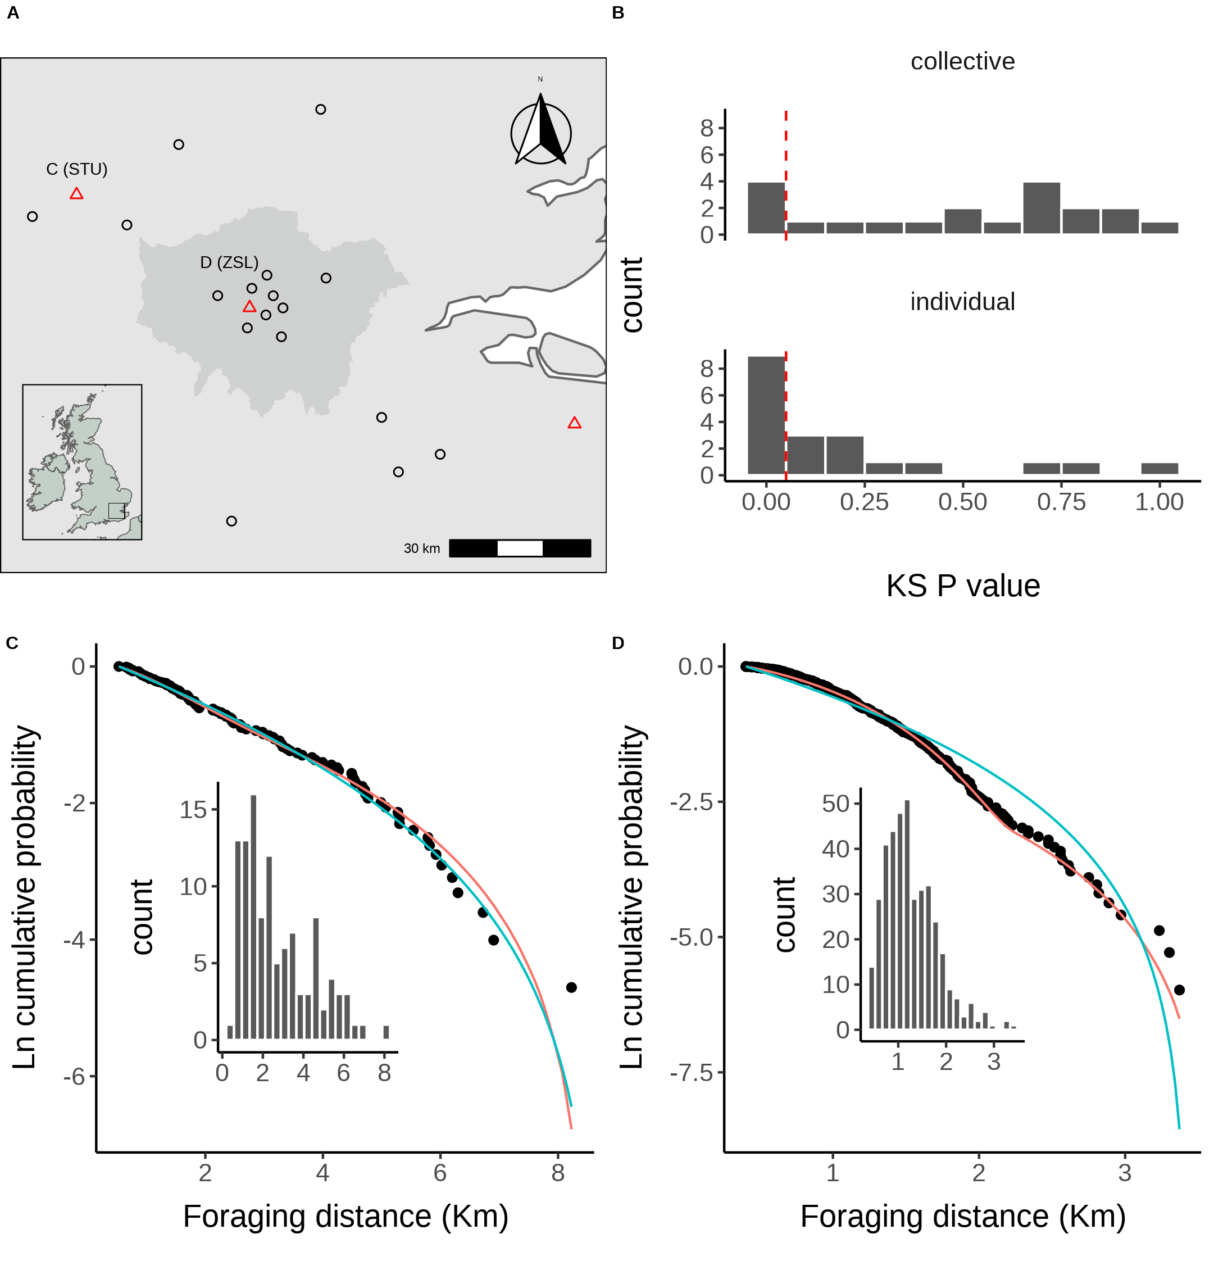
p
+
(1-p)
A. Location of study hives in Southern England coloured by which model, collective (black circles) or individual (red triangles) provided the best explanation of the data as indicated by lowest AIC score. Sites STU and ZSL (C & D) are marked. Inset plot shows the location of the sites within the UK. B. Distribution of goodness of fit confidence values for each model fit to waggle dance derived foraging distances from each site. P value is derived from a bootstrapped two-sided KS test comparing the fitted model predictions to the empirical data. The red dashed line marks the significance threshold of 0.05. Values greater than 0.05 indicate no statistically significant difference is observed between the model and the data, indicating the model provides a good fit to the data.
Notes:
So, here are the result of fitting our models to each site. On the map here you can see hive locations marked with either a red triangle, indicating the individual model provided the better fit, or black circles indicating the collective model provided the better fit. As you can see, in the majority of sites, 17 in fact, the collective model provided the best fit. This suggests that in the majority of cases honeybees forage collectively, but in some sites foraging is better explained by a strategy of ignoring the dance and foraging independently.
On the right here is a distribution of KS statistic P values. This is out goodness of fit test to see if the models we fit actually resemble the data. Here, a p value greater than 0.05, shown by this red dashed line, indicates there is no significant difference between our models fit and the underlying data. Overall, the collective model is statistically indistinguishable from the data in 16 sites. Whilst this is only 11 in the individual case, these results suggests our models provide a good explanation of the underlying data.
Now we know the models fit well, we can explore how the proportion of scout estimates, p, for each site is influenced by the environment of that site.

Slide 7
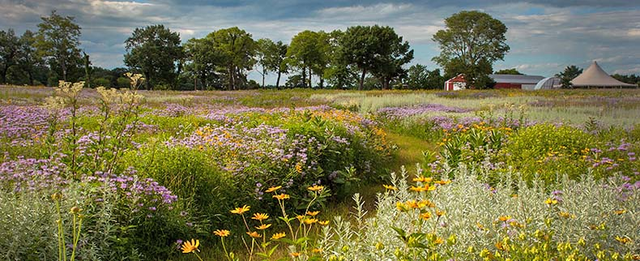
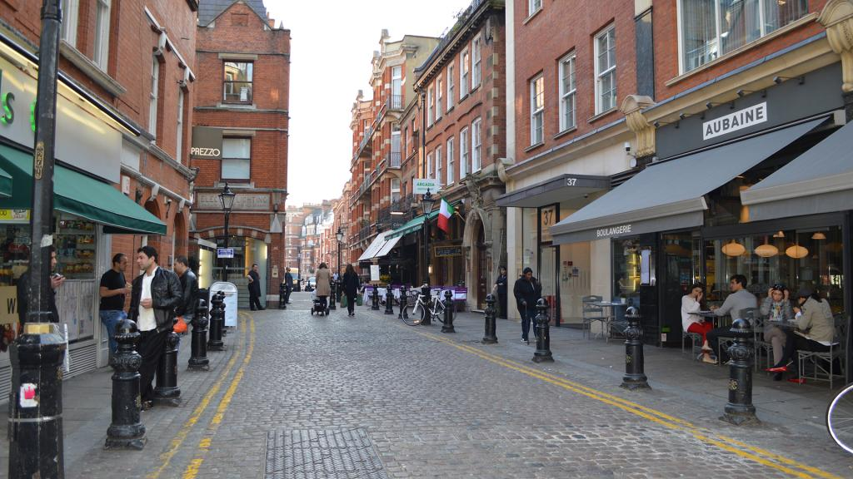
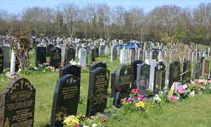
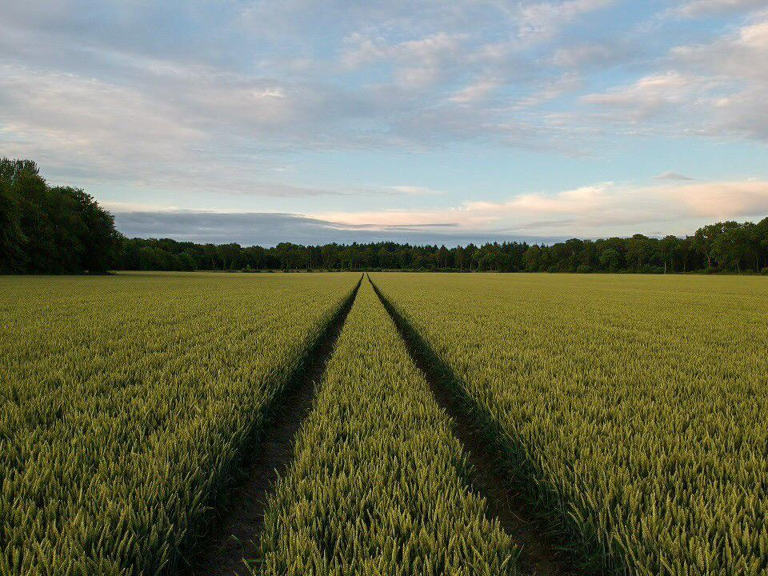
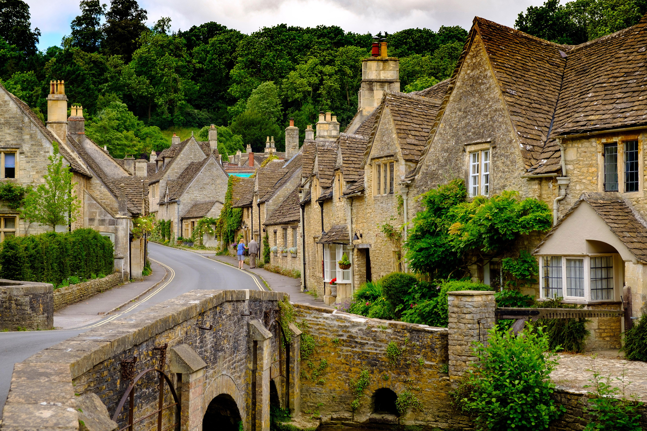
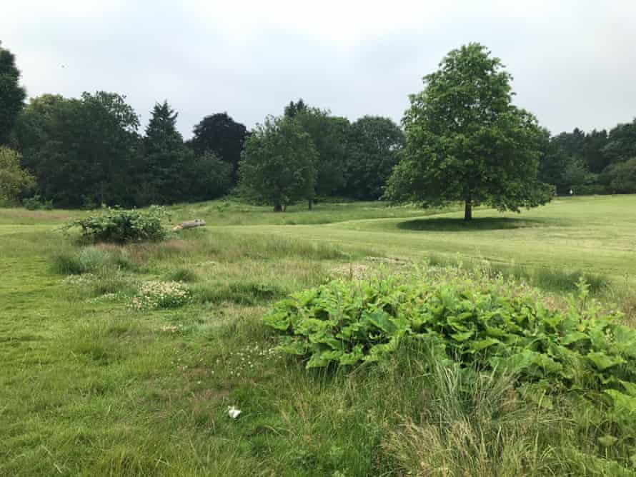
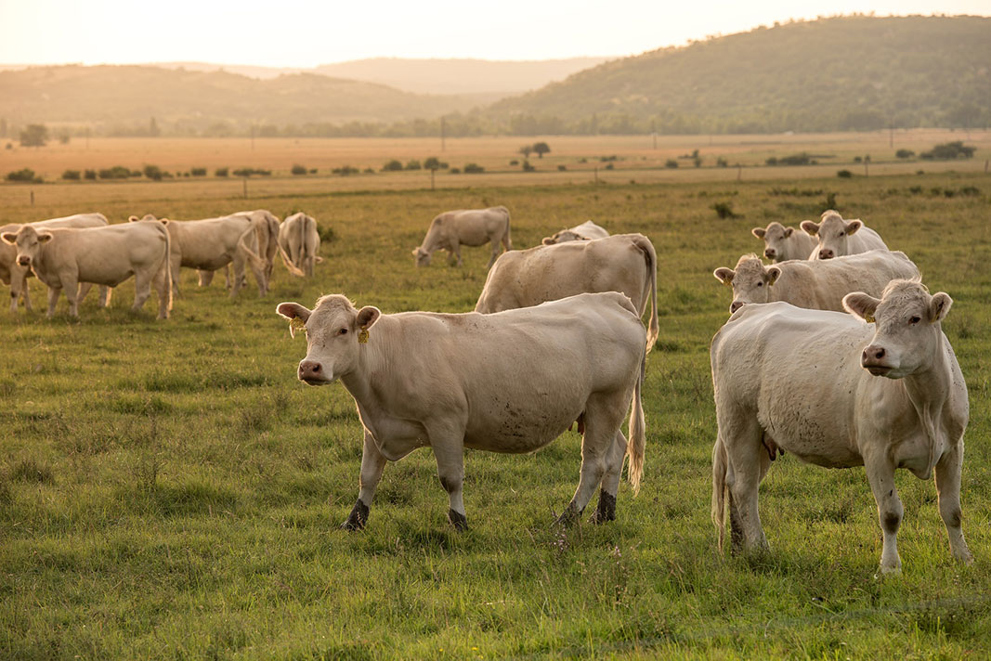
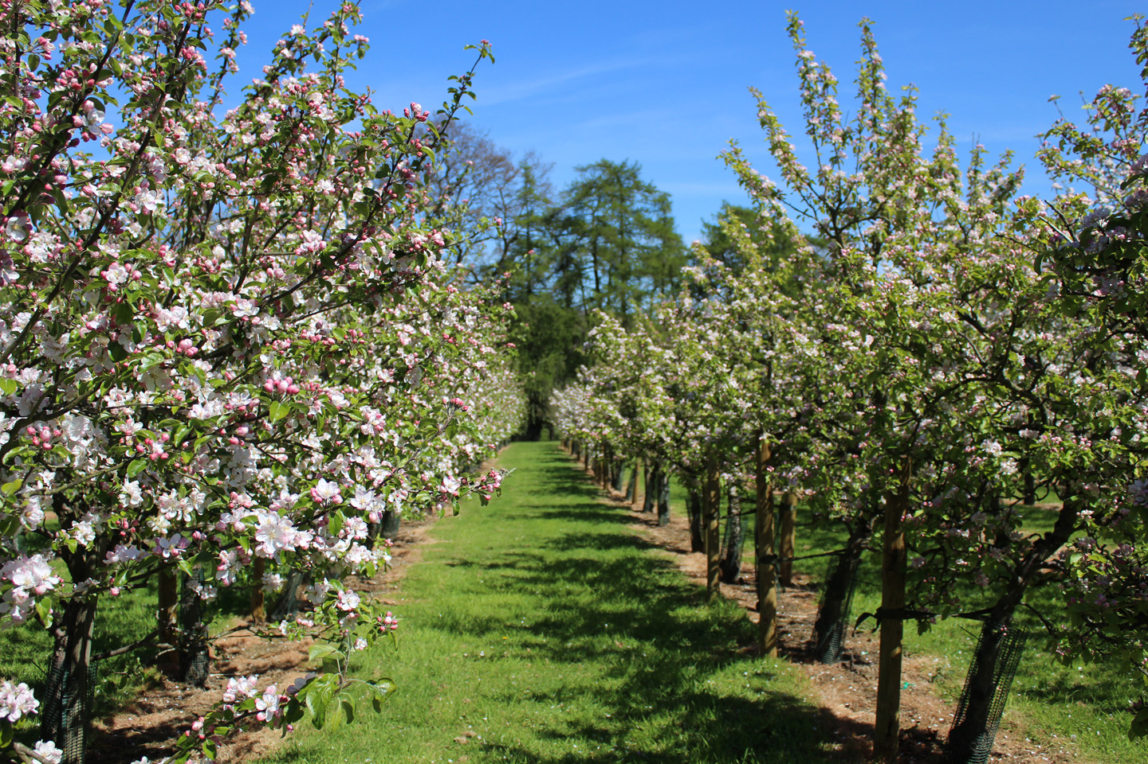
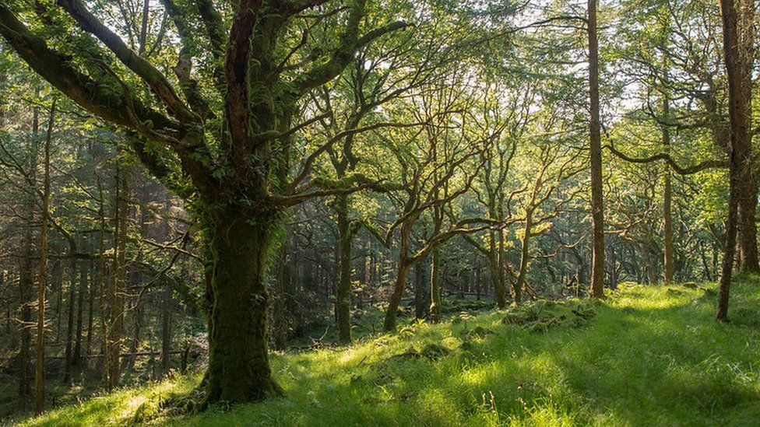
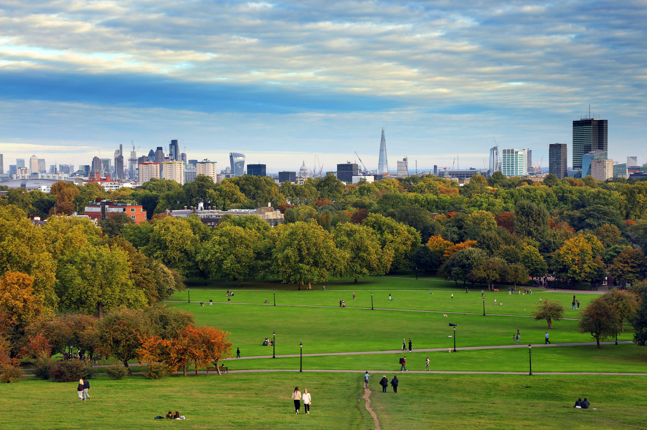
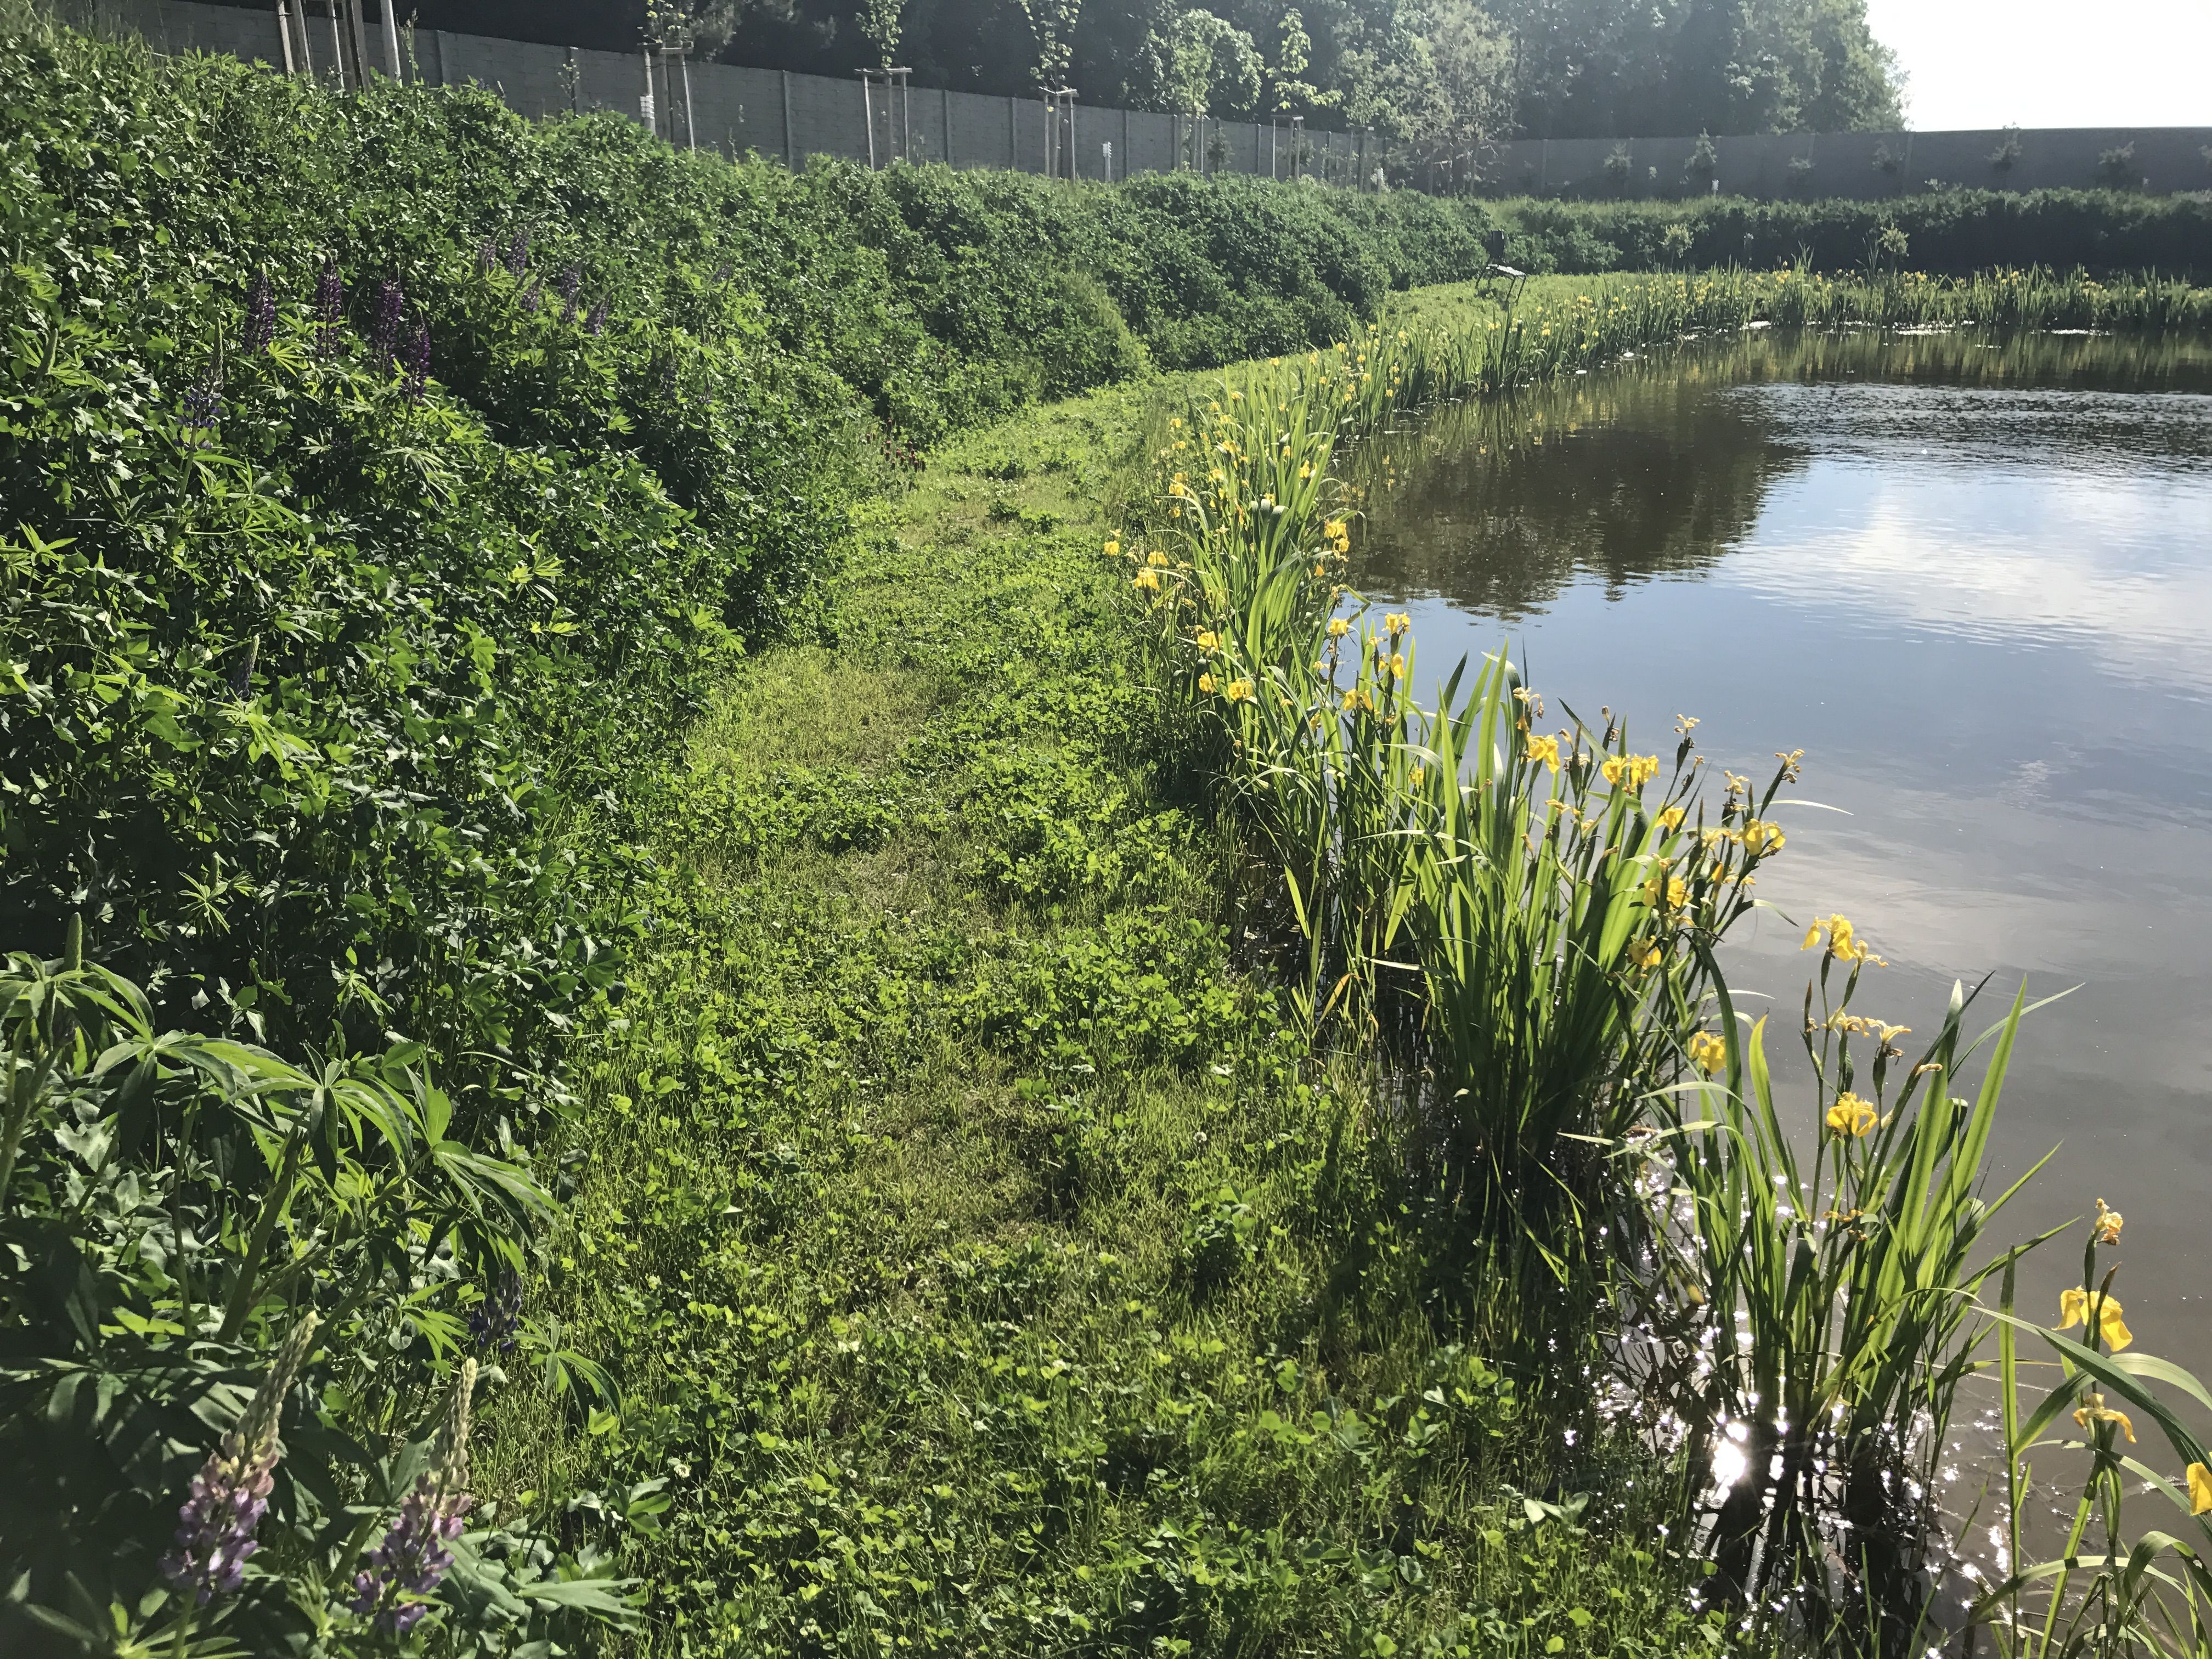
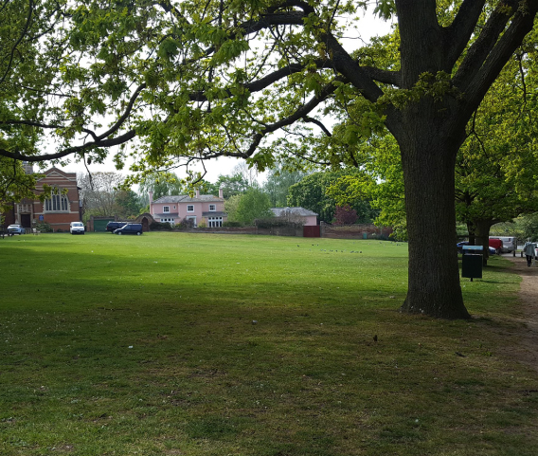
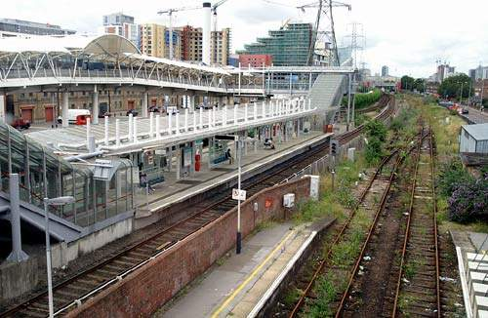
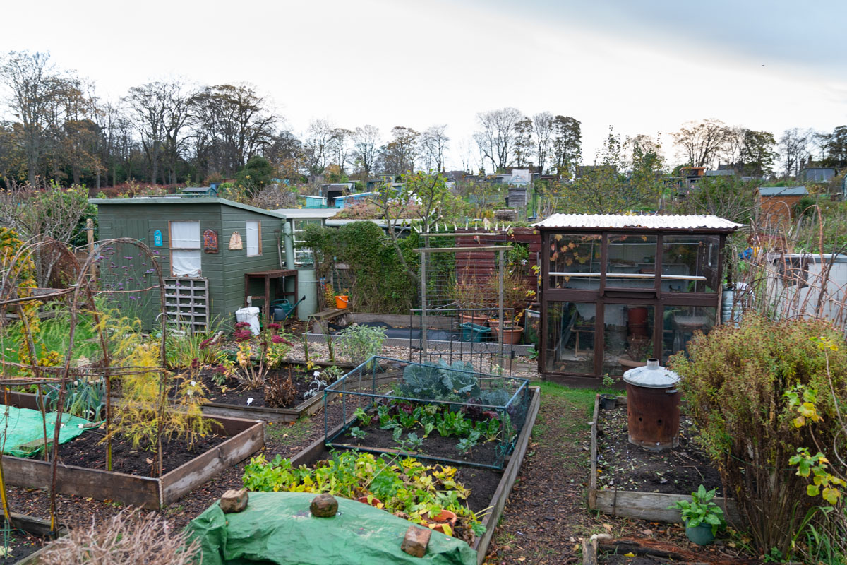
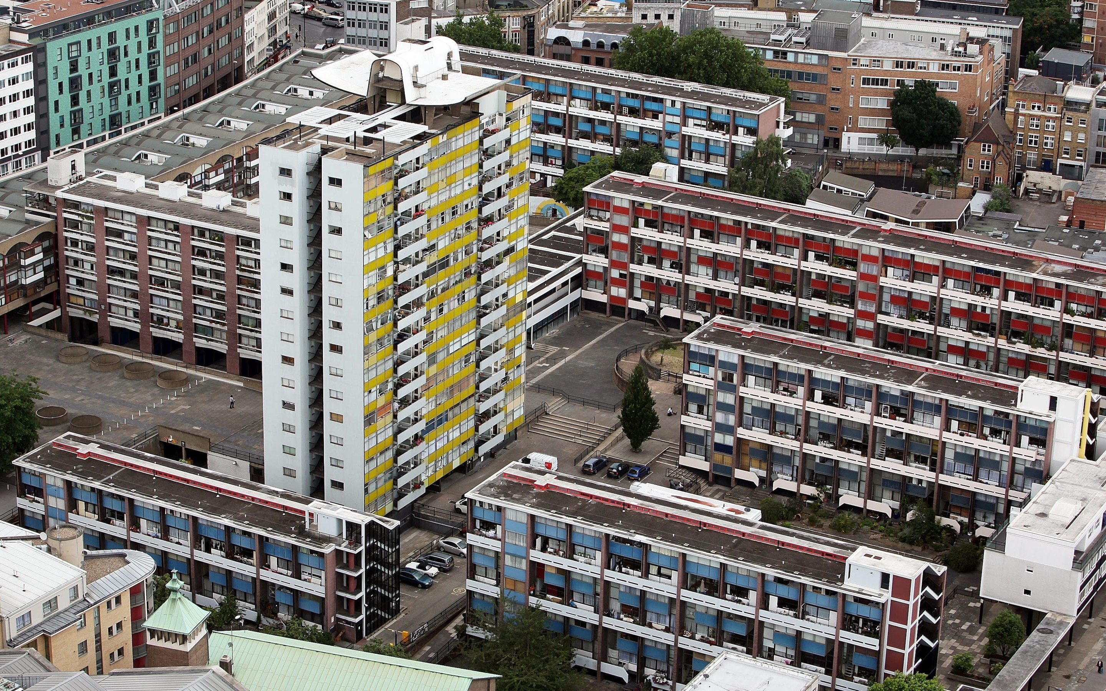

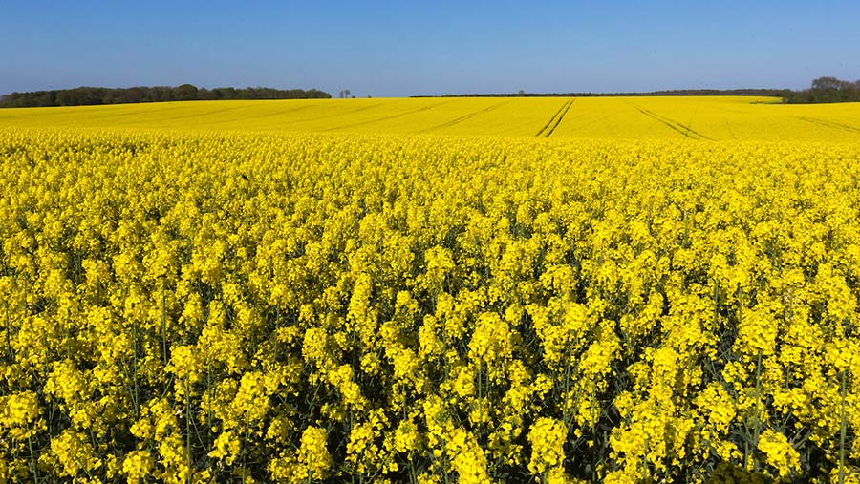
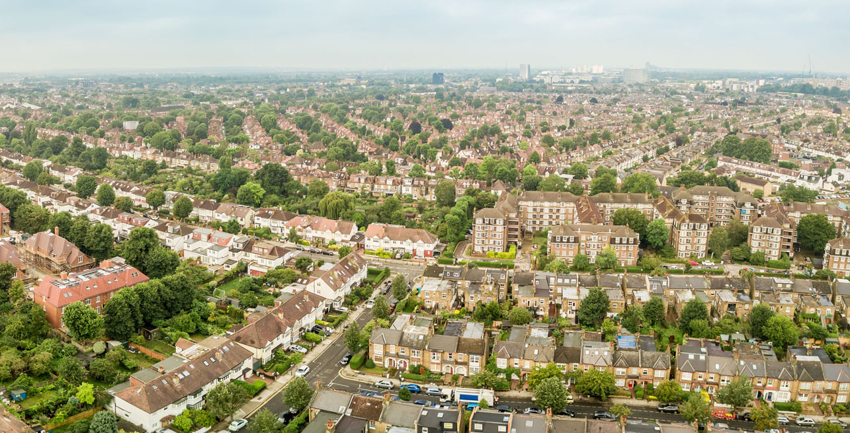
Agri-rural
Urban
Notes:
Within both of our environments we classified land-use type and calculated proportional coverage within that site. For example, in the urban environment each site would have had a certain combination of things like continuous central, dense and sparse residential and parks, whilst in the agri-rural it would be combinations of arable land, unmanaged and managed green spaces and built up areas, etc. As many of these land-use types correlate with one another, we used a Partial Least Squares analysis to identify the main axis of land use-type which best explains the variation in the proportion of scouts estimated for each site.

Slide 8
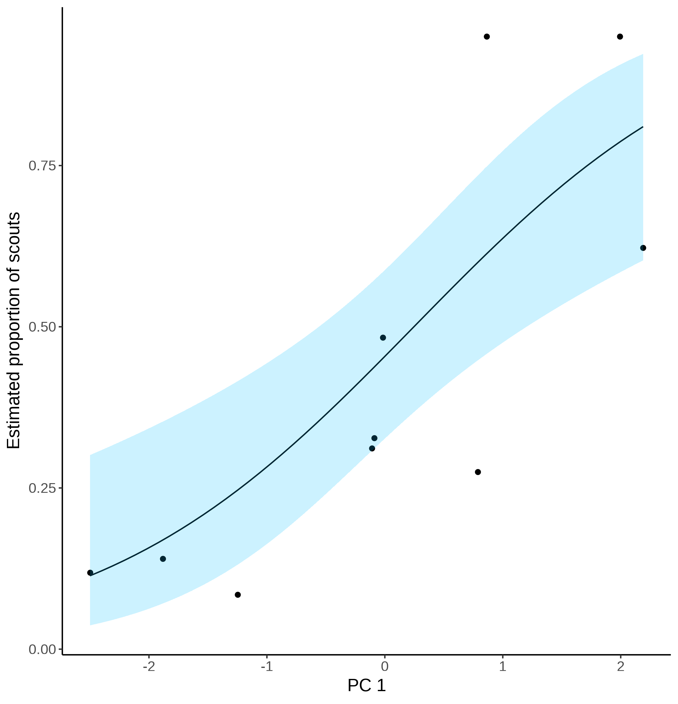
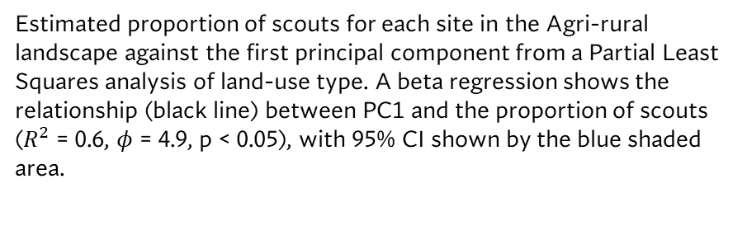
Agri-rural
Land-use type loadings for the first principal component on the Agri-rural sites. Bold face indicates loadings that contribute more than would be expected under a null hypothesis of equal contribution
Estimated proportion of scouts for each site in the Agri-rural landscape against the first principal component from a Partial Least Squares analysis of land-use type. A beta regression shows the relationship (black line) between PC1 and the proportion of scouts ($R^{2}$ = 0.6, $φ$ = 4.9, p < 0.05), with 95% CI shown by the blue shaded area.
Notes:
In the Agri-rural environment we identified a single PC explained about 60% of the variation in the proportion of scouts and had a significant positive correlation.
When we looked at this PC we saw that it correlated negatively with Non-agricultural unmanaged green space, bult up areas and water, whilst correlating positively with arable land. This indicates that when arable land increases and when unmanaged green spaces, built up areas and water decrease, the proportion of scout dances and so the colonies use of the waggle dance decreases.

Slide 9
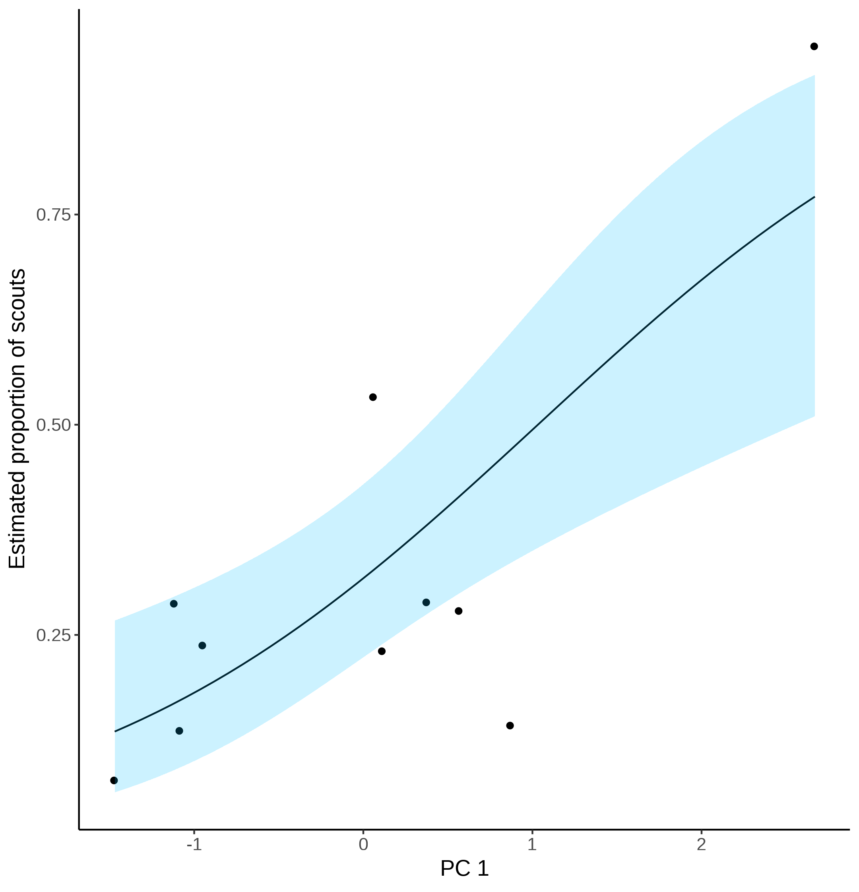
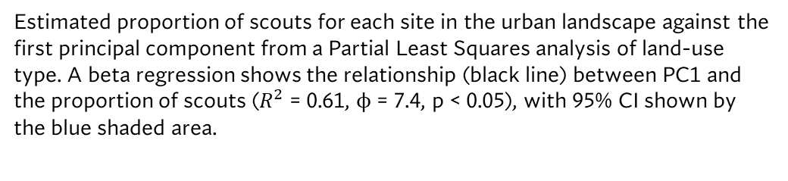
Urban
Land-use type loadings for the first principal component on the urban sites. Bold face indicates loadings that contribute more than would be expected under a null hypothesis of equal contribution
Estimated proportion of scouts for each site in the urban landscape against the first principal component from a Partial Least Squares analysis of land-use type. A beta regression shows the relationship (black line) between PC1 and the proportion of scouts ($R^{2}$ = 0.61, ϕ = 7.4, p < 0.05), with 95% CI shown by the blue shaded area.
Notes:
We see a similar effect in the urban environment. Here, a single PC explains around 61% of the variation in the proportion of scouts with a significant positive correlation, although much of this is driven by this single site up here. When we drill down into this PC we see it correlates positively with continuous central land, dense residential and water, so less attention paid to the waggle dance when these increase, and negatively with sparse residential and amenity grassland, increasing the use of the waggle dance in these environments.

Slide 10

Have developed an innovative tool to quantify waggle dance use & evaluate collective foraging!
The use of the waggle dance depends upon the land-use type of the environment
Honeybees don’t always forage collectively!
Notes:
So to summerise, what we have done is develop and innovative tool to quantify waggle dance use, allowing us to better evaluate collective foraging.
When we applied this to real waggle dance observations from colonies foraging on the landscape, we find that honeybees don’t always forage collectively
and by evaluating environmental factors, we see that the use of the waggle dance depends on the land-use type of the environment. Whilst we have limited data to make any grandiose statements of exactly how the environment drives waggle dance use, our results seem to support previous studies findings and provides a new methodology to evaluate this behavior further as waggle dance data becomes easier to collect.

Slide 11

Thank you for listening!
Acknowledgments
Ash Samuelson, Elli Leadbeater & Vincent Jansen
Any questions?

Slide 12
C. Model fits to waggle dance derived foraging distances collected from the ZSL hive along with histogram showing distribution. D. Model fits to waggle dance derived foraging distances collected from the STU hive along with histogram showing distribution. Model fits show the compliment cumulative frequency distribution, giving the probability of sampling a value greater than or equal to x

Slide 13
Honeybees don’t always forage collectively!
Honeybees appear to forage collectively in the majority of sites
In some sites, foraging is explained best by a model of personal information use
These results support the idea that the environment influences the use of the waggle dance.
Allows us to probe how the environment influences information use in more detail
How does land-use type influence waggle dance use?

Slide 14
Individuals report where they’ve been on the dance-floor
The type of foraging strategy (personal or social information), should influence the patterns of dances reported.

Slide 15
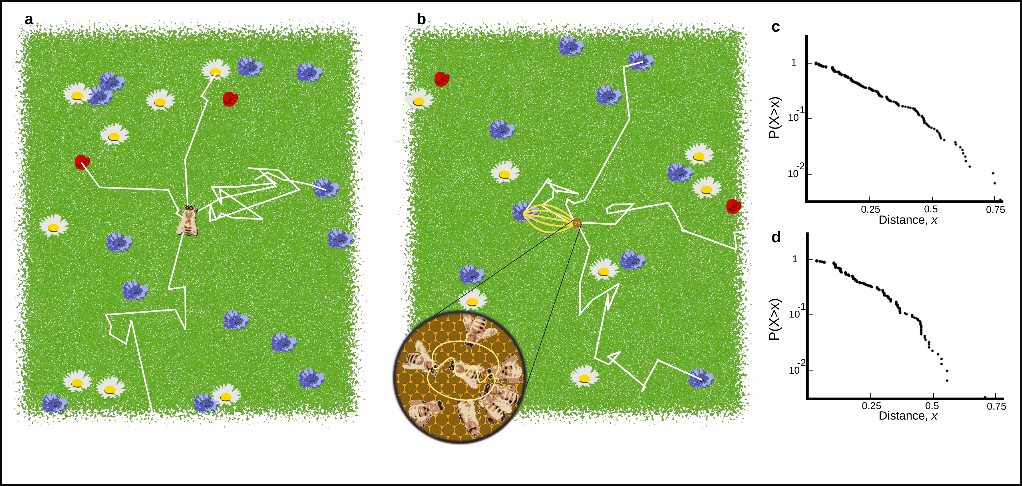
A. Outline of scout foraging. Scouts leave the hive on a random flight path (white lines) and continue until they encounter a resource (flowers in the figure). B. Outline of foraging with recruitment. Scouts continue to identify resources but recruits sample available dances provided by recruits and other scouts. C. Log inverse frequency distribution of foraging distances reported by scouts. D. Log inverse frequency distribution of foraging distances reported by recruits.

Slide 16

How to evaluate the influence of the environment on foraging?
Compare actions of individuals against a collective
We can often observe an individual, or a collective, but not both.
Need methods to tease apart collective and individual foraging in honeybees
Apply this to empirical data on honeybee foraging in different landscapes
+
Vs.

Slide 17
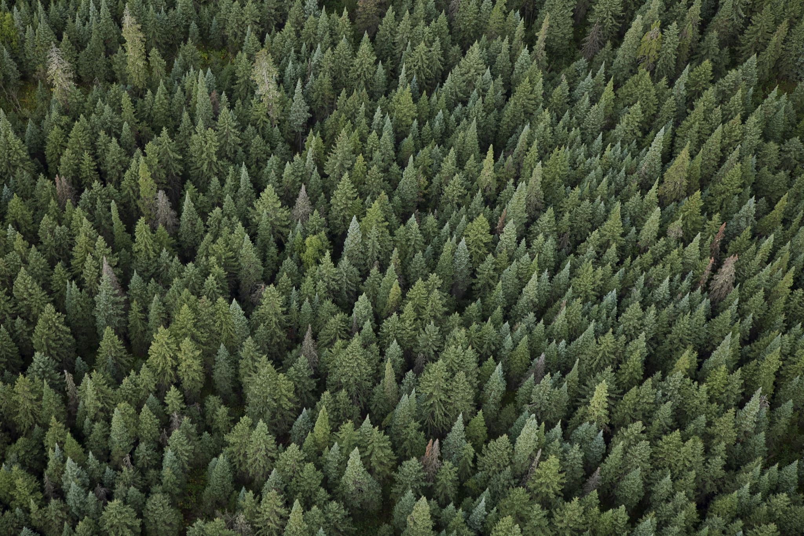
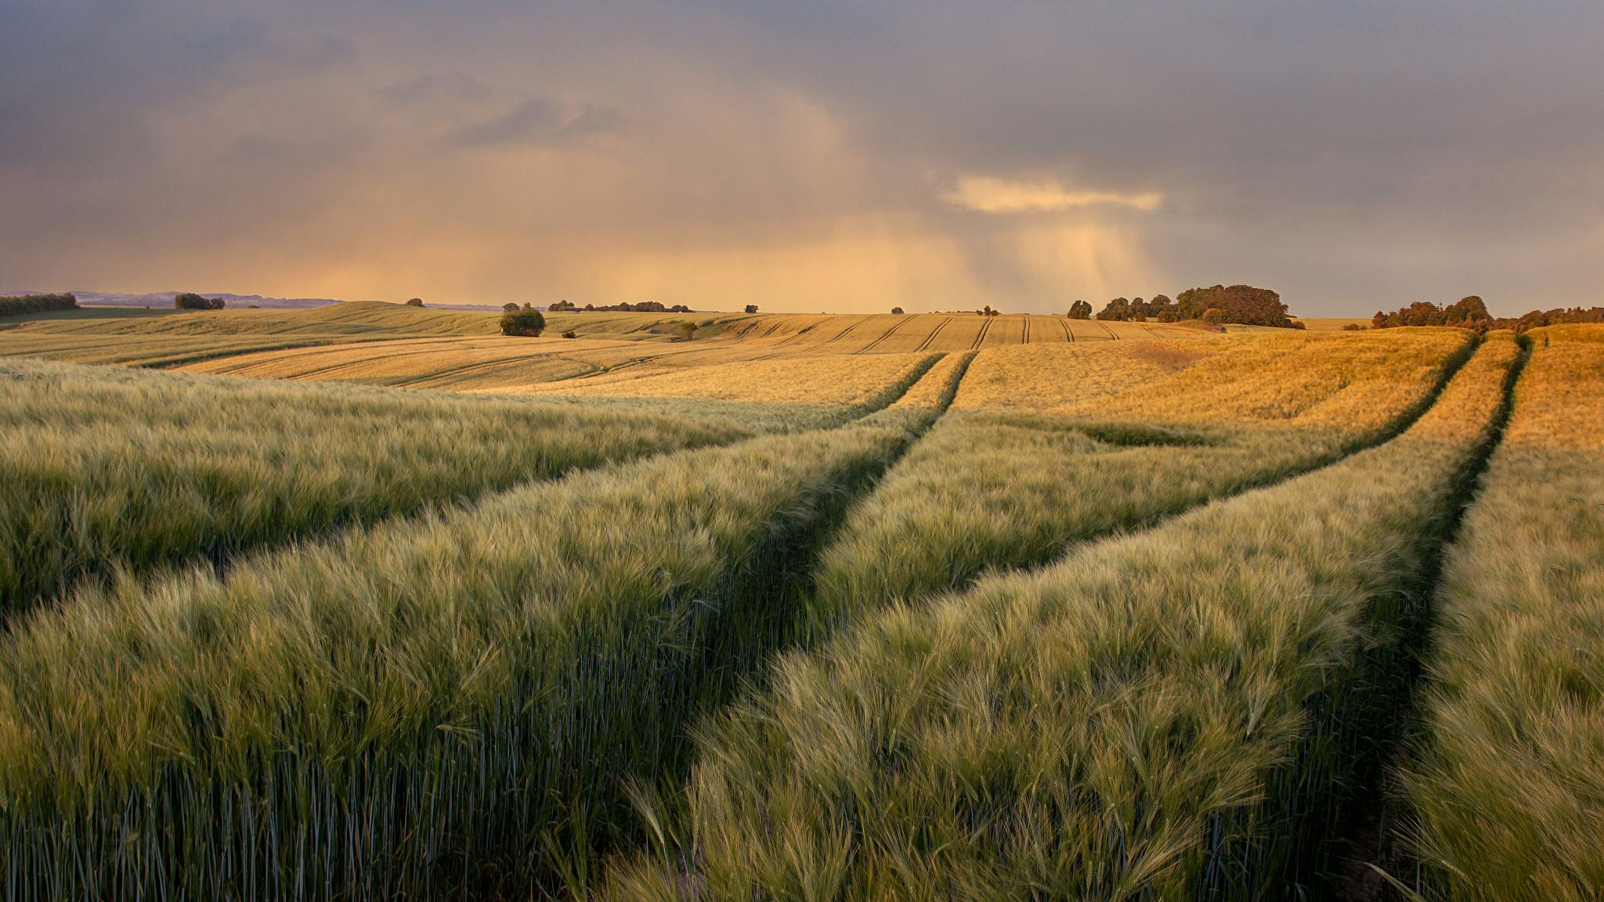
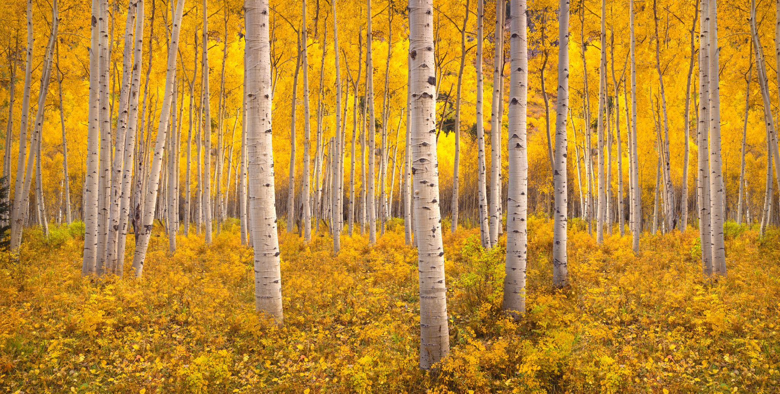
The environment is thought to influence waggle dance use
Prioritise personal information
(Act like a scout)
Prioritise Social information
(Act like a recruit)

Slide 18

The type of foraging strategy (personal or social information use), influences the patterns of dances reported.
Now to construct a model that can be applied to real waggle dance data

Slide 19
Model
p
+
=
(1-p)

